Slide 1
SHARED AND DISTINCT BRAIN NETWORKS
in Working Memory & Emotion Processing
fMRI evidence from the Human Connectome Project — Young Adult dataset
Neuromatch Academy — Computational Neuroscience

Slide 2

About Us
Team Warrior Squirrels:
Apurva Awasthi
Janindu Pahalawatta
Divya
Mariia Sysuieva
Uğur Özgür Yıldız
Siddharth Kashyap
Kumail Haider Ganaie
Nasra Ismail Mohamed
Maitreyee Bhagwat
Anna Plieva

Slide 3
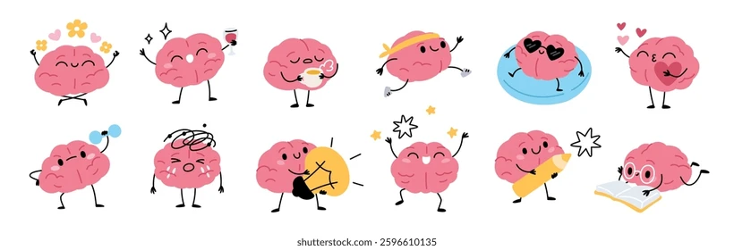
One Brain. Many Tasks.
Does it rely on the same neural toolkit?
Notes:
"Our brain performs thousands of operations every day—from remembering information to interpreting emotional experiences. We often think of these as completely different functions, each relying on its own specialized brain regions. But the brain is remarkably efficient. Instead of building a new circuit for every challenge, it frequently reuses flexible control networks. This idea makes sense for closely related processes like attention and decision-making—but does it also apply to two seemingly different domains such as working memory and emotion? That question forms the basis of our study."

Slide 4
WE EXPECTED EACH TASK TO ACTIVATE ITS OWN SPECIALIZED BRAIN REGIONS, WHILE ALSO PREDICTING THAT THEY WOULD CONVERGE ON A COMMON SET OF CONTROL NETWORKS, PARTICULARLY THE FRONTOPARIETAL AND DORSAL ATTENTION NETWORKS, WHICH HELP COORDINATE COMPLEX BEHAVIOUR REGARDLESS OF THE TASK.
Hypothesis

Slide 5

100 Young adults | 3T fMRI | High Resolution Images
Notes:
Examined 3T task-fMRI data from 100 individuals, from the Human Connectome Project-Young Adult dataset

Slide 6
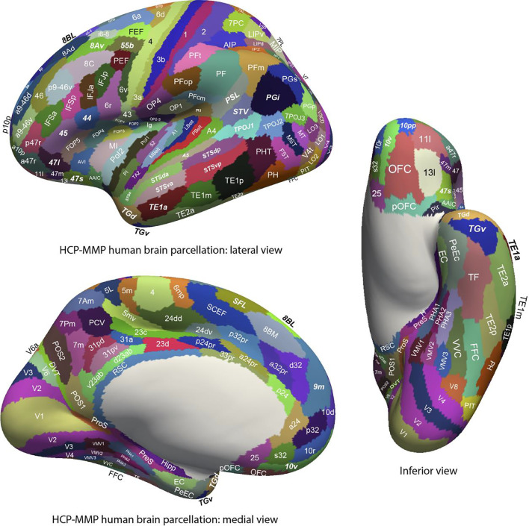
Parcellation of
Human Brain
(HCP-MMP)
Notes:
The dataset was preprocessed and parcellated using the Glasser Atlas parcellation [4]

Slide 7


Fear/ Neutral
N-Back task
2 Back / 0 Back
Notes:
focusing on the working memory and emotion experiments

Slide 8
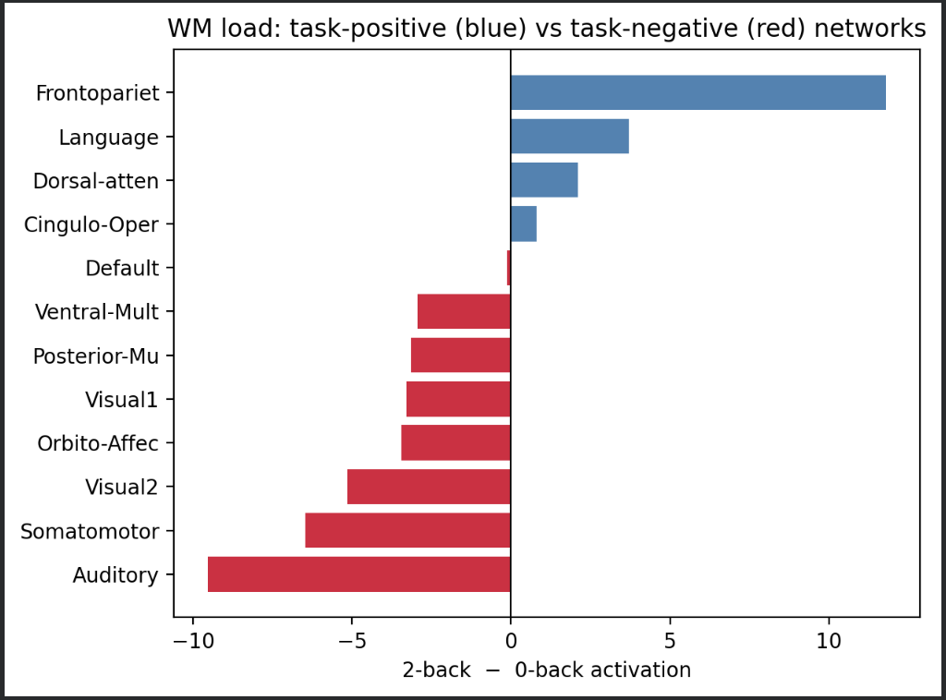
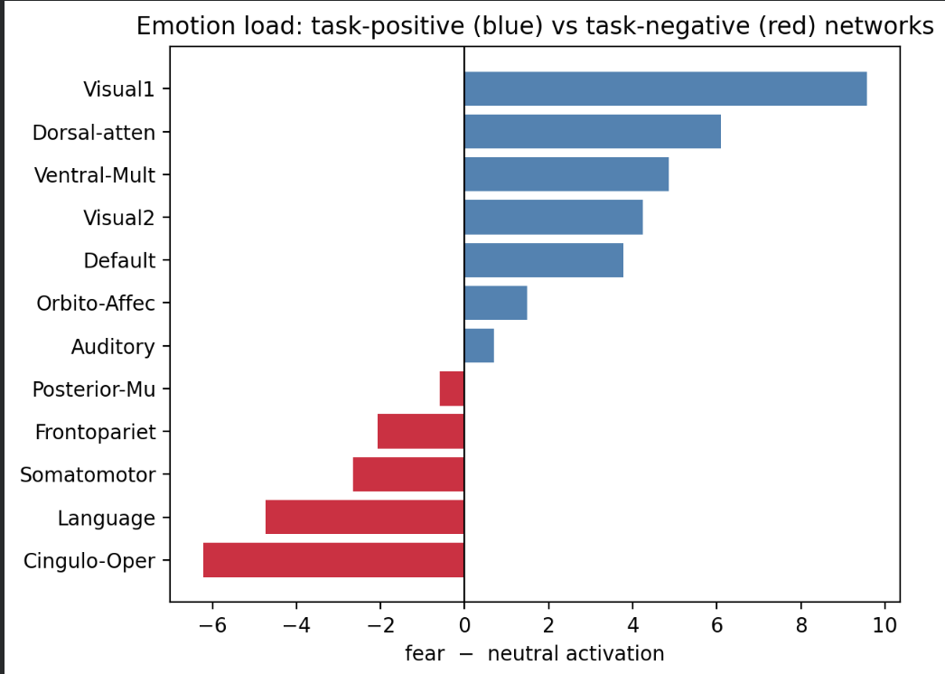
Mass univariate analysis. Comparing mean bold activation between task and control, for WM & EM
Notes:
Janindu slide 1:
Our initial analysis involved identify regions of increased or decreased bold activity for our 2bk memory task compared to our control working memory task.
We also did the same for our emotional processing task
Here we see the increased and decreased activation for our working memory and emotional processing tasks, on a network level scale.
Frontoparietal (WM), Cingulo-opercular network (EM)
For our next steps, we wanted to break these large-scale networks into smaller reg

Slide 9
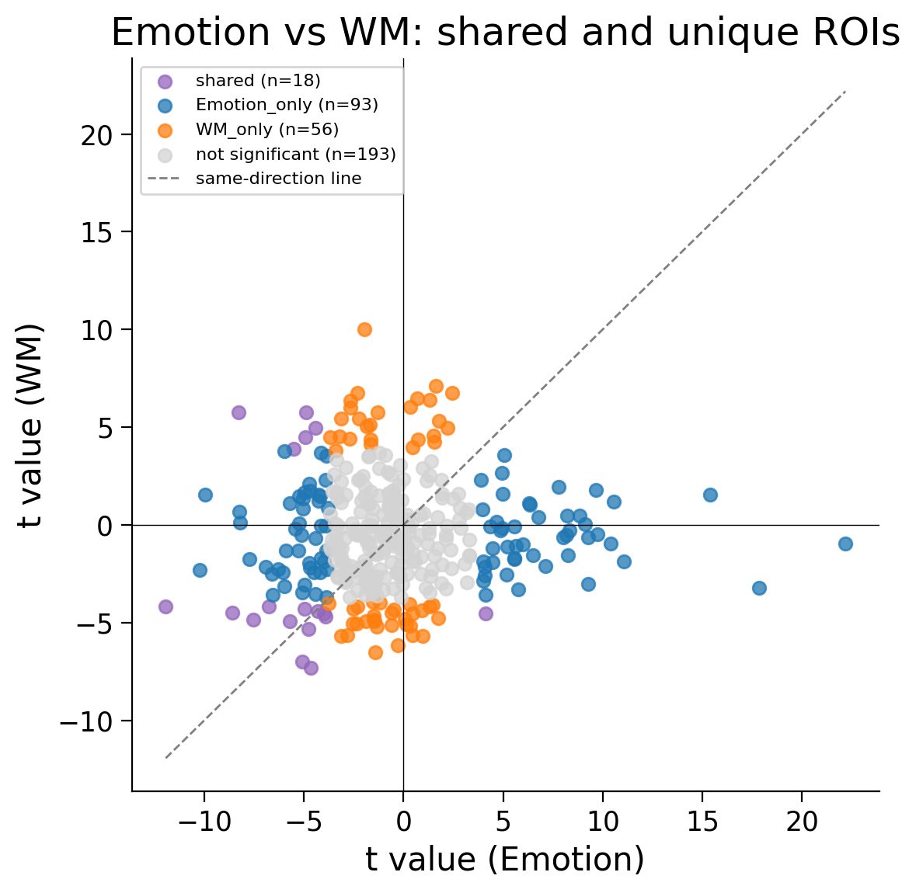
Permutation T-test Results
Notes:
Janindu slide: 2 - starting discussion on t-tests
Compared each of 360 ROI. Identified 126 regions with signif
Issue with false discovery rates

Slide 10
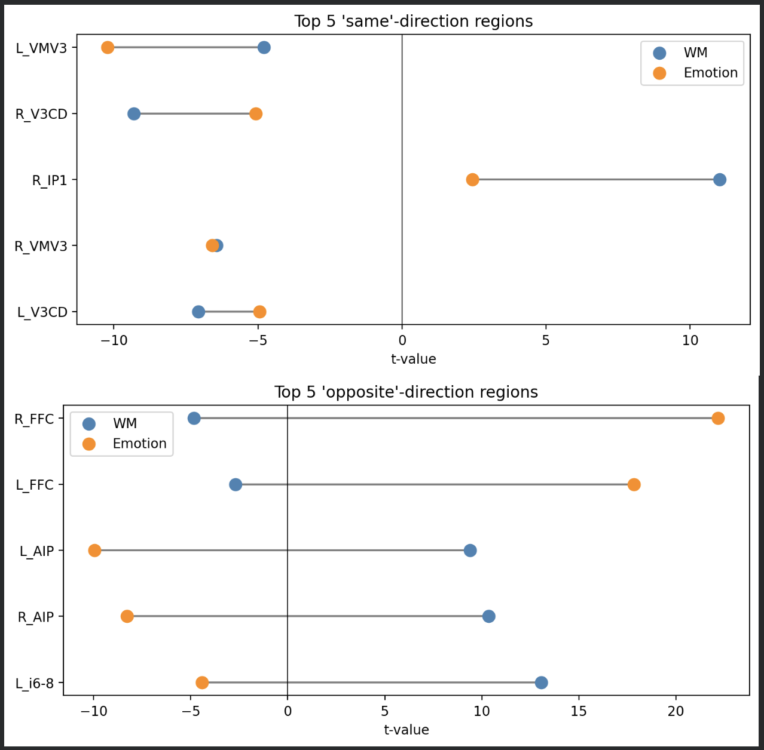
Top Regions of Interest and their activation/deactivation directions

Slide 11
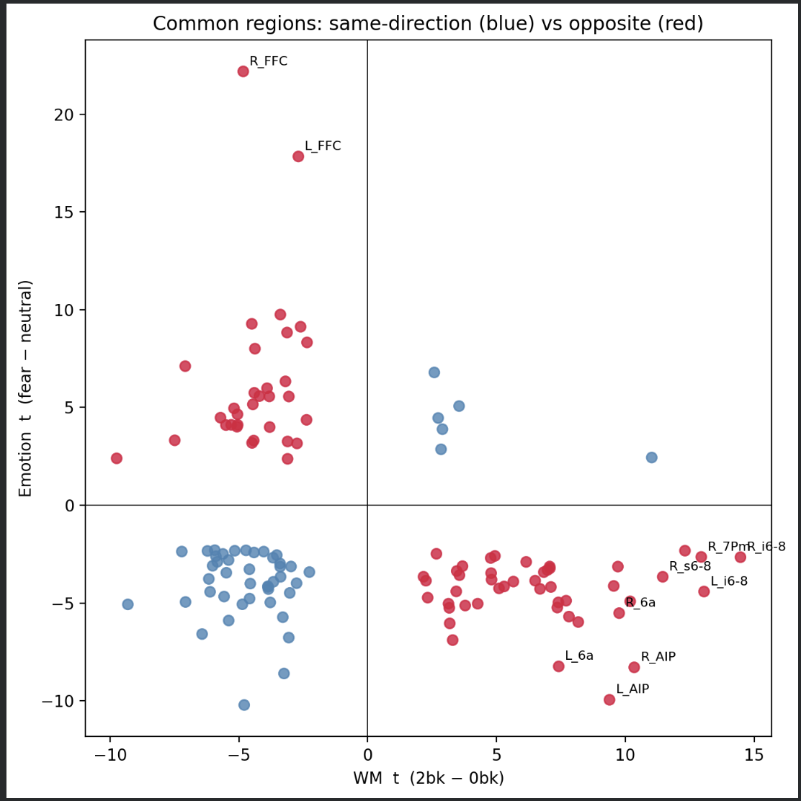
1 Sample T-testing Results

Slide 12
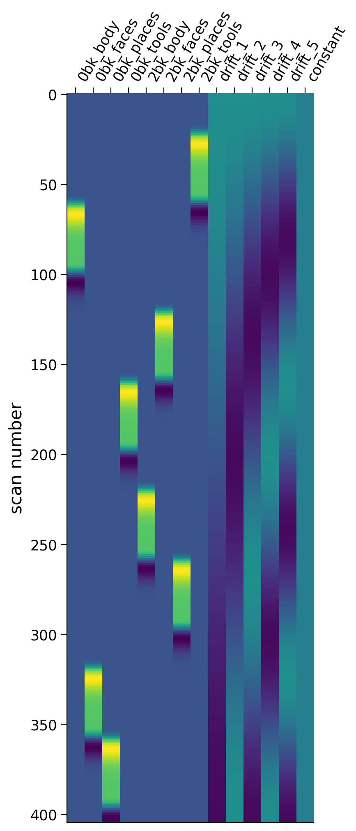
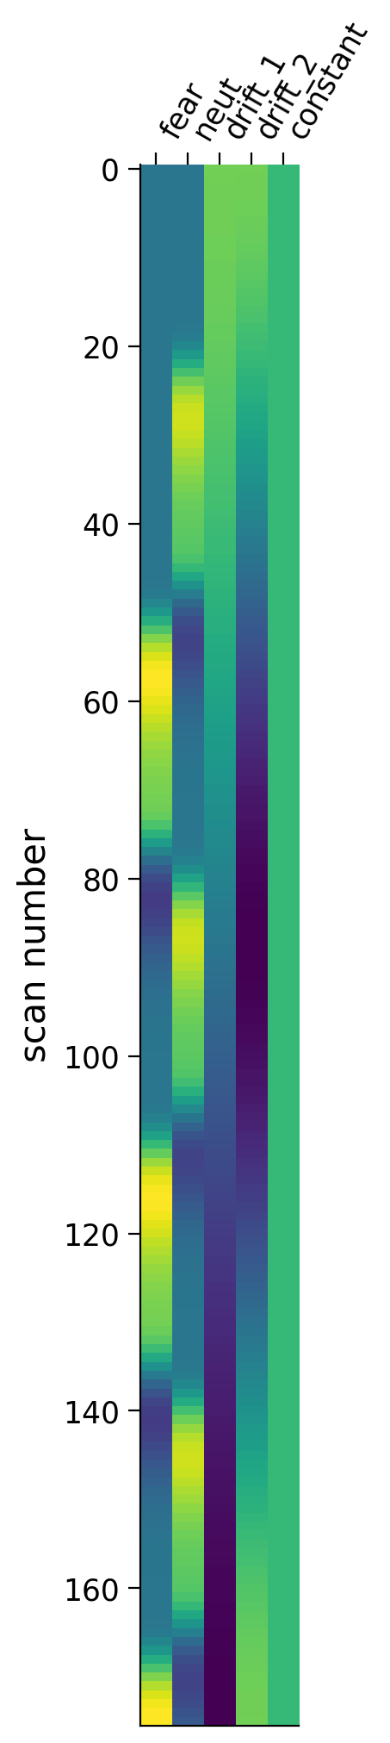
Methods: GLM. Design Matrix
We created Design matrix for both datasets and used function make_first_level_design_matrix() from nilearn with default parameters hrf_model='glover', drift_model='cosine'.
For WM we have 8 regressors and 2 regressors for Emotion
Fig. 1 Design matrix for 1 subject for Working Memory dataset
Fig. 1 Design matrix for 1 subject for Emotion dataset

Slide 13
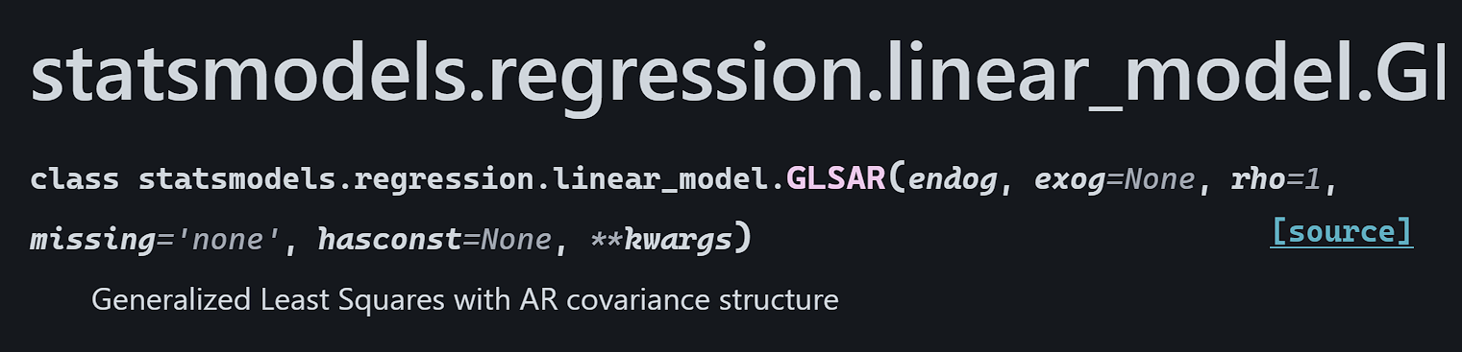
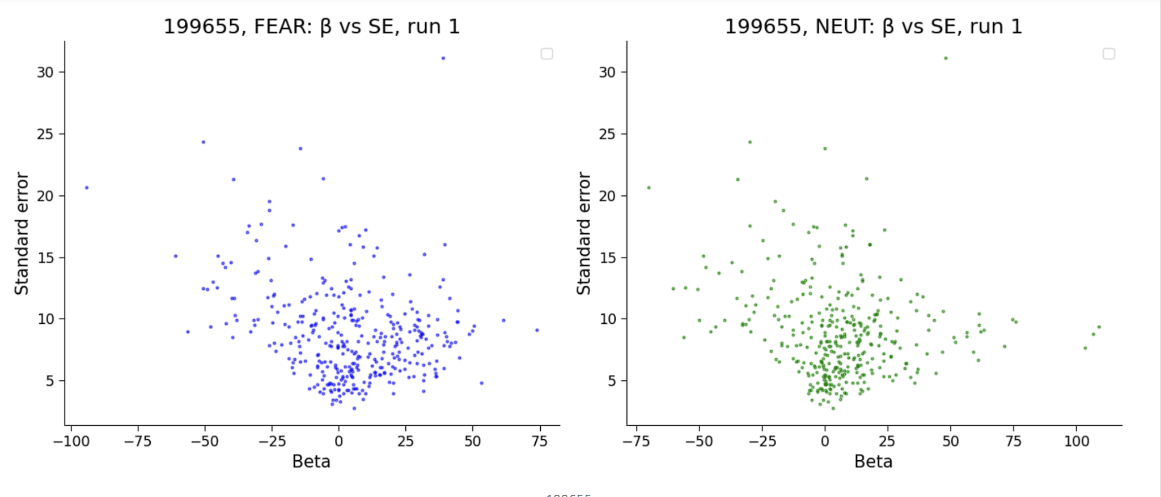
Methods: GLM. Betas and SE
We performed a subject-wise GLM analysis using statsmodels on a parcel . For each subject and run, we estimated beta coefficients and uncertainty (SE) and created MNE- reports for each dataset (Emotion, WM) to check every subject.
Fig 3. Betas and SE (uncertainty) for Fear condition and for Neut condition. Example from our report for one subject (id 199655)

Slide 14
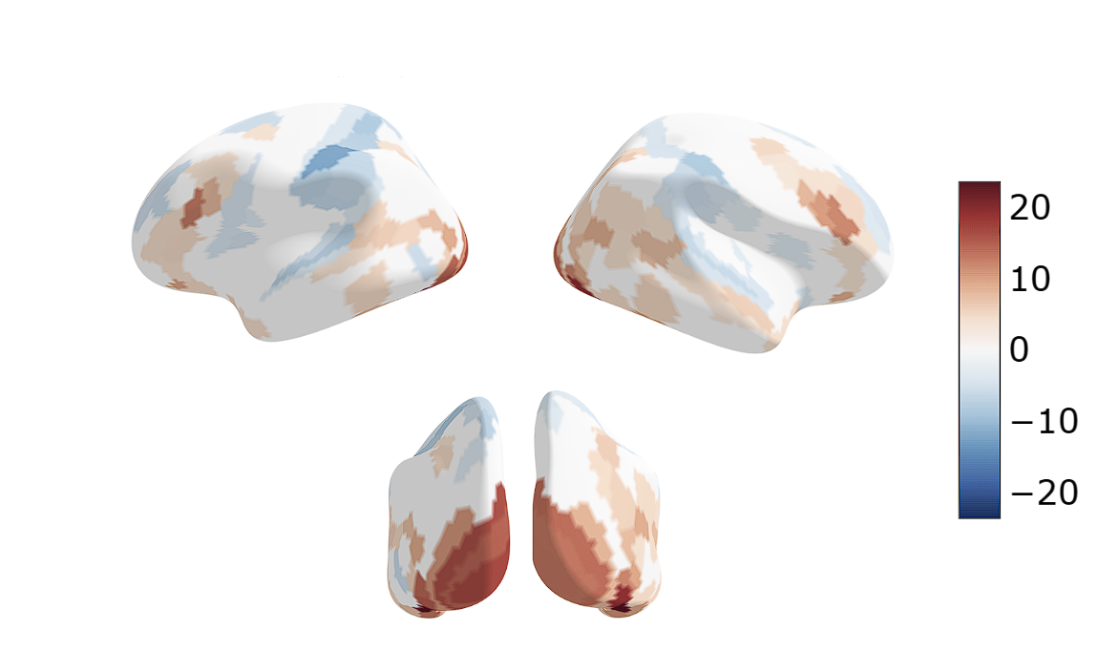
Results: GLM. Group analysis
Distribution of t-values where p < 0.05 for EMOTION dataset (Holm corrected)
llll
The t-statistics were obtained as a result of the one-sample t-test in group analysis (Emotion > Neutral contrast) using GLM. Only parcels with Holm‑corrected p‑values < 0.05 are displayed.

Slide 15
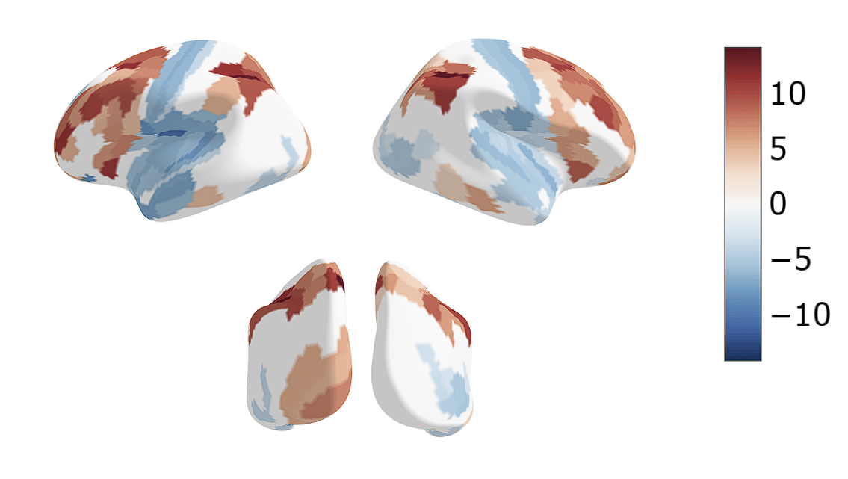
Results: GLM. Group analysis.
Distribution of t-values where p < 0.05 for Working Memory dataset (Holm corrected)
The t-statistics were obtained as a result of the
one-sample t-test in group analysis (0back> 2back) using GLM. Only parcels with Holm‑corrected p‑values < 0.05 are displayed.

Slide 16
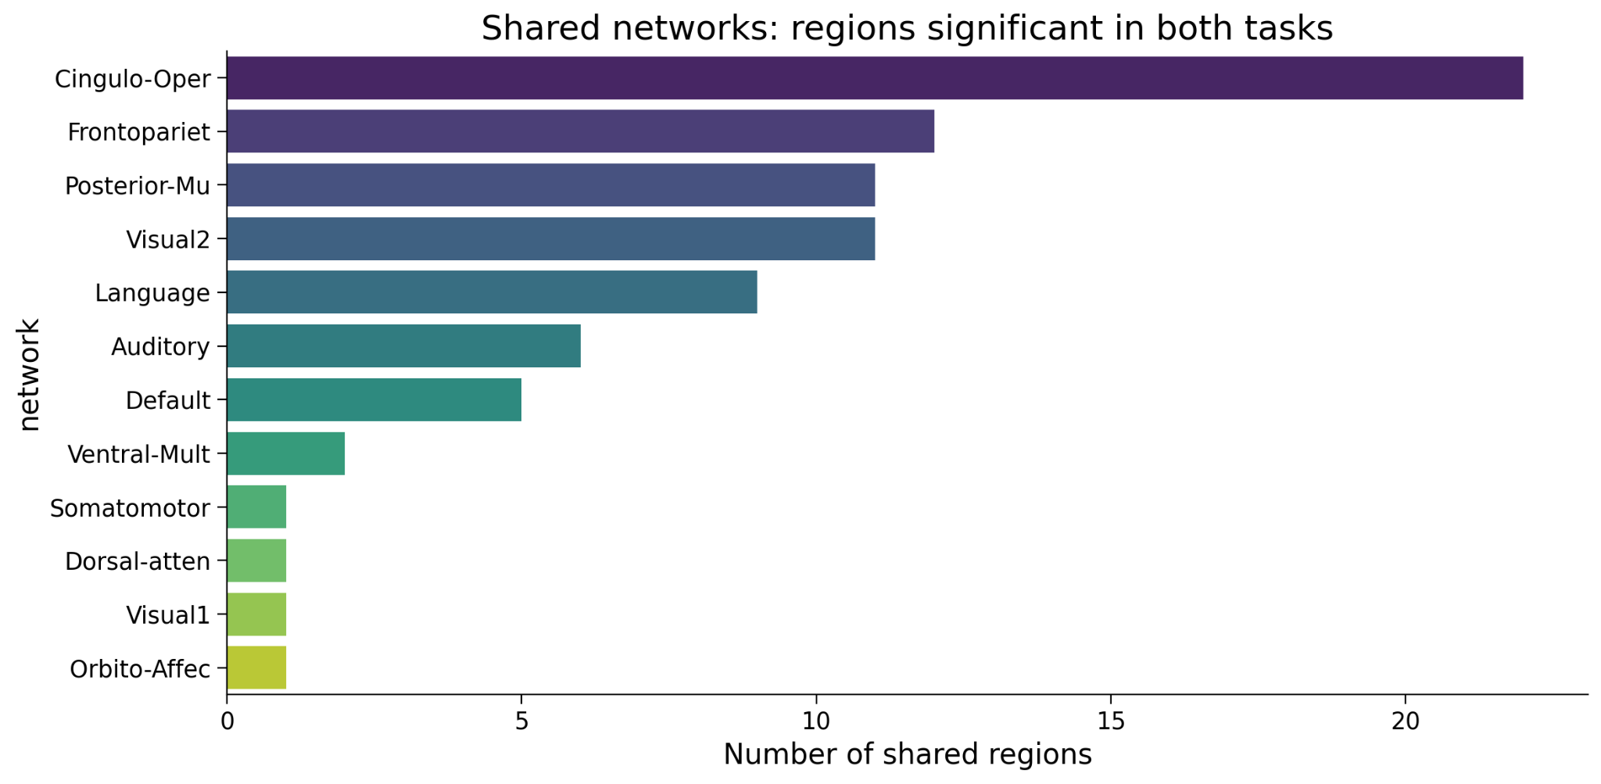
Results: GLM. Group analysis
Fig 3. Networks with shared regions significant in both task (GLM)

Slide 17
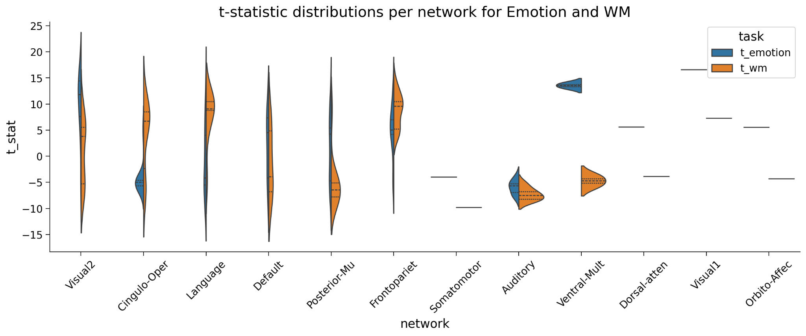
Results: GLM. Group analysis
Fig.4 Distribution of t values for networks with significant regions (GLM)

Slide 18
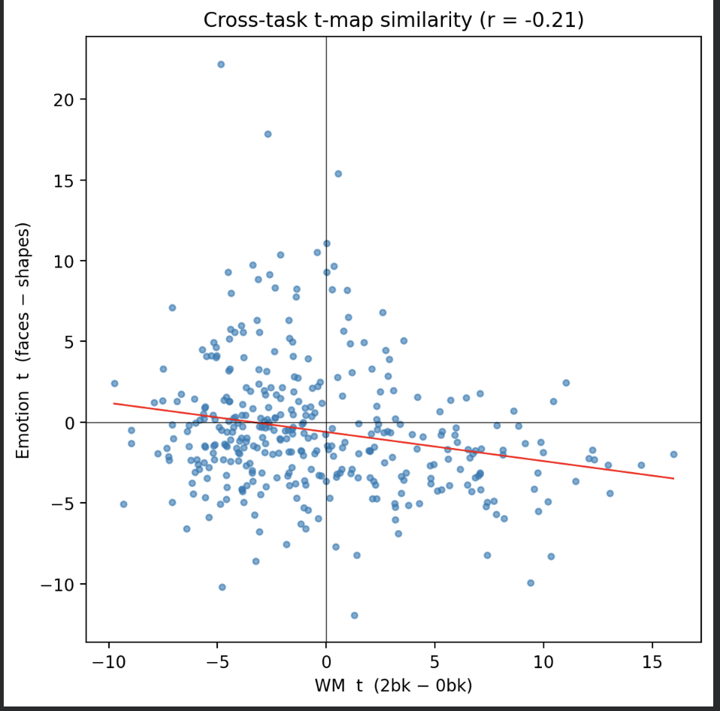
Possible Anti correlation between the Tasks

Slide 19
What This Means — And What's Next
✓
Emotion and working memory share a substantial cortical footprint 35% of parcels concentrated in domain-general control systems rather than scattered randomly.
→ FUTURE WORK
Network-Based Statistics (NBS)
✓
The findings reinforce the view of shared “executive hub” networks (FPN, DAN) that integrate diverse cognitive demands, not just WM-specific processing.
Will further characterize the dynamics of these shared and distinct networks at the connectivity level moving from where activation overlaps to how these regions communicate during task performance.
✓
Novelty: most prior shared-network work uses voxel-based analysis; this uses a parcellated (Glasser 360) approach, and the WM-vs-emotion pairing specifically hasn't been the focus of prior studies.
Glasser et al., 2016, Nature · Assem et al., 2020, Cerebral Cortex · Human Connectome Project – Young Adult

Slide 20
Bibliography
Rolls, Edmund T., et al. “The Human Language Effective Connectome.” NeuroImage, vol. 258, June 2022, p. 119352. https://doi.org/10.1016/j.neuroimage.2022.119352.
Brosch, Tobias, et al. “The Impact of Emotion on Perception, Attention, Memory, and Decision-making.” Swiss Medical Weekly, vol. 143, no. 1920, May 2013, p. w13786. https://doi.org/10.4414/smw.2013.13786.
Seeburger, Dolly T., et al. “Time-varying Functional Connectivity Predicts Fluctuations in Sustained Attention in a Serial Tapping Task.” Cognitive Affective & Behavioral Neuroscience, vol. 24, no. 1, Jan. 2024, pp. 111–25. https://doi.org/10.3758/s13415-024-01156-1.
Pessoa, Luiz. “Understanding Brain Networks and Brain Organization.” Physics of Life Reviews, vol. 11, no. 3, Apr. 2014, pp. 400–35. https://doi.org/10.1016/j.plrev.2014.03.005.
Glasser, Matthew F., et al. “A Multi-modal Parcellation of Human Cerebral Cortex.” Nature, vol. 536, no. 7615, July 2016, pp. 171–78. https://doi.org/10.1038/nature18933.
Assem, Moataz, et al. “A Domain-General Cognitive Core Defined in Multimodally Parcellated Human Cortex.” Cerebral Cortex, vol. 30, no. 8, Jan. 2020, pp. 4361–80. https://doi.org/10.1093/cercor/bhaa023.

